Slide 1
PROPULSION ENGINEERING

Slide 2
WHAT IS PROPULSION
PRO –Before OR Forward
PELLERE –To push or drive an object
PROPULSION –To push or drive an object forward

Slide 3
AIRCRAFT ENGINE
Petrol engine : 1876 by German inventor NA OTTO.
Jet propulsion precedes piston engine hundreds of years
1903:CharlieTaylor built an inline aeroengine for the first successful flight by wright brothers at kitty hawk.

Slide 4
PRINCIPLE OF JET PROPULSION
Working of jet propulsion is based on newton’s third law .
When fluid is to be accelerated, force is required to produce acceleration in the fluid.
At the same time, there is an equal and opposite reaction force on the engine which is known as thrust. Working of jet propulsion is based on the reaction principle

Slide 5
CLASSIFICATION OF AIRCRAFT ENGINES
AIR BREATHING ENG
RKT ENGINES
RECIPROCATING OR PROPELLER
ENGINES
CHEMICAL RKT ENG
GAS TURBINE ENGINES
COMB OF DUCTED JET ENG
AND RKT ENG
RAMJET ENGINES
NUCLEAR RKT ENG
PULSE JET ENGINES
ELECT RKT ENG

Slide 6
PROPULSION
Air breathing engines. Engines which use combustion gases produced by burning of fuel using atmospheric air.
Rocket engines. Engines which use jet of gas produced by the chemical reaction of the fuel and oxidizer. Each of them is carried within the system itself. No atmospheric air is used .

Slide 7
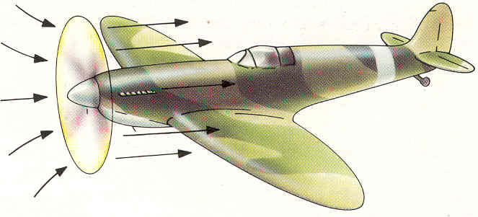
RECIPROCATING ENGINES

Slide 8
OTTO CYCLE
EXPANSION
COMBUSTION
P
COMPRESSION
EXHAUST
SUCTION
V

Slide 9
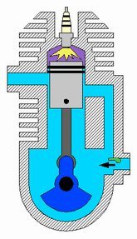
TWO STROKE ENGINE

Slide 10
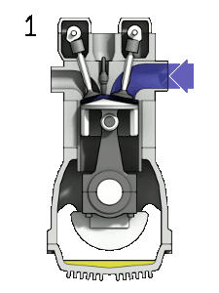
FOUR STROKE ENGINE

Slide 11
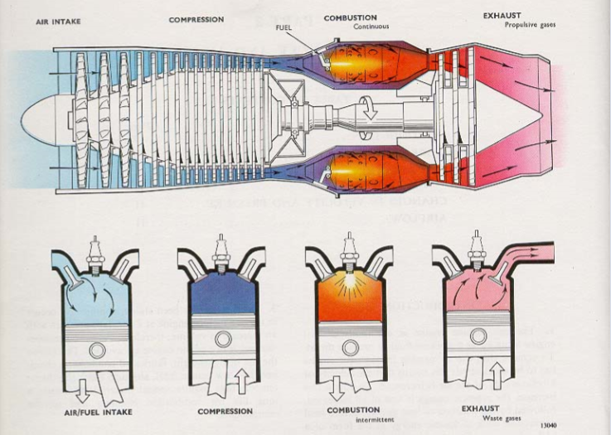
VARIOUS STAGES OF FOUR STROKE ENGINE

Slide 12
Disadv of Const Vol Cycle
Thermal η of const vol cycle is higher
Mechanical difficulties are higher
For heat addition at const vol valves are reqd to isolate C.C
Combustion is intermittant which impairs smooth running
Difficult to design

Slide 13
RECIPROCATING ENGINES
Used extensively as an aircraft powerplant during world WAR I &II
It drives a propeller. Propeller displaces rearwards a large amount of air, accelerating it in the process
This acceleration of the fluid produces a propulsive force which drives the aircraft

Slide 14
RECIPROCATING ENGINES
ADVANTAGES
Fuel economy and good take off characteristics
Used in small aircraft flying at velocities less than 500 km/hr
DISADVANTAGES
Large drop in power with altitude
Need for using high octane fuel
Difficulty in cooling and lubrication
High weight to power ratio
Large frontal area

Slide 15
AIRCRAFT PROPULSION AND ITS BACK GROUND
Gas turbine-means of producing mech power
Turbine is the most satisfying means of producing mech power. Reasons:-
Few balancing problems
Low oil consumption
High reliability

Slide 16
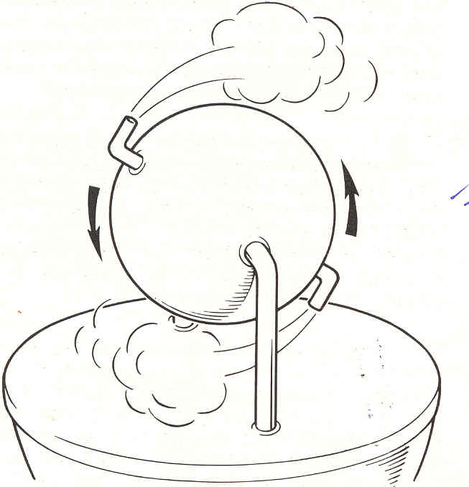
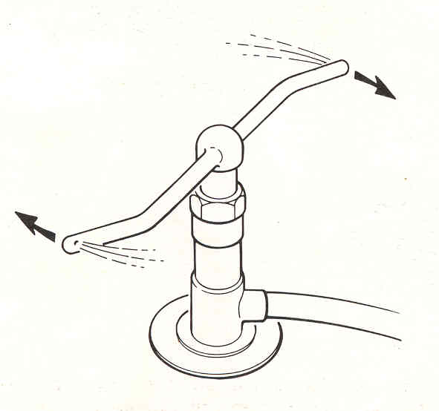
PRINCIPLE OF JET PROPULSION
HERO’S ENGINE
GARDEN SPRINKLER

Slide 17
SOME INTERESTING FACTS
Jet engine-world war II
Sir Frank Whittle & Han Von Ohain
Whittle engine -1929 called power jets W.I. Flew on British Gloster g.40 on 15 may 1941.
Von Ohlin engine HES 3B IN HEINKEL HE 178.
British eng-centrifugal comp & German eng axial flow comp.

Slide 18
BRAYTON CYCLE
comb
P
exp
comp
suction
exhaust
V

Slide 19
SIMPLE GAS TURBINE
FUEL
CC
3
1
EXHAUST
2
4
COMP
TUR
AIR
POWER O/P

Slide 20
TYPES OF GAS TURBINE ENGINES
TURBO-JET
TURBOPROP
TURBOFAN
TURBOSHAFT
PROPFAN

Slide 21
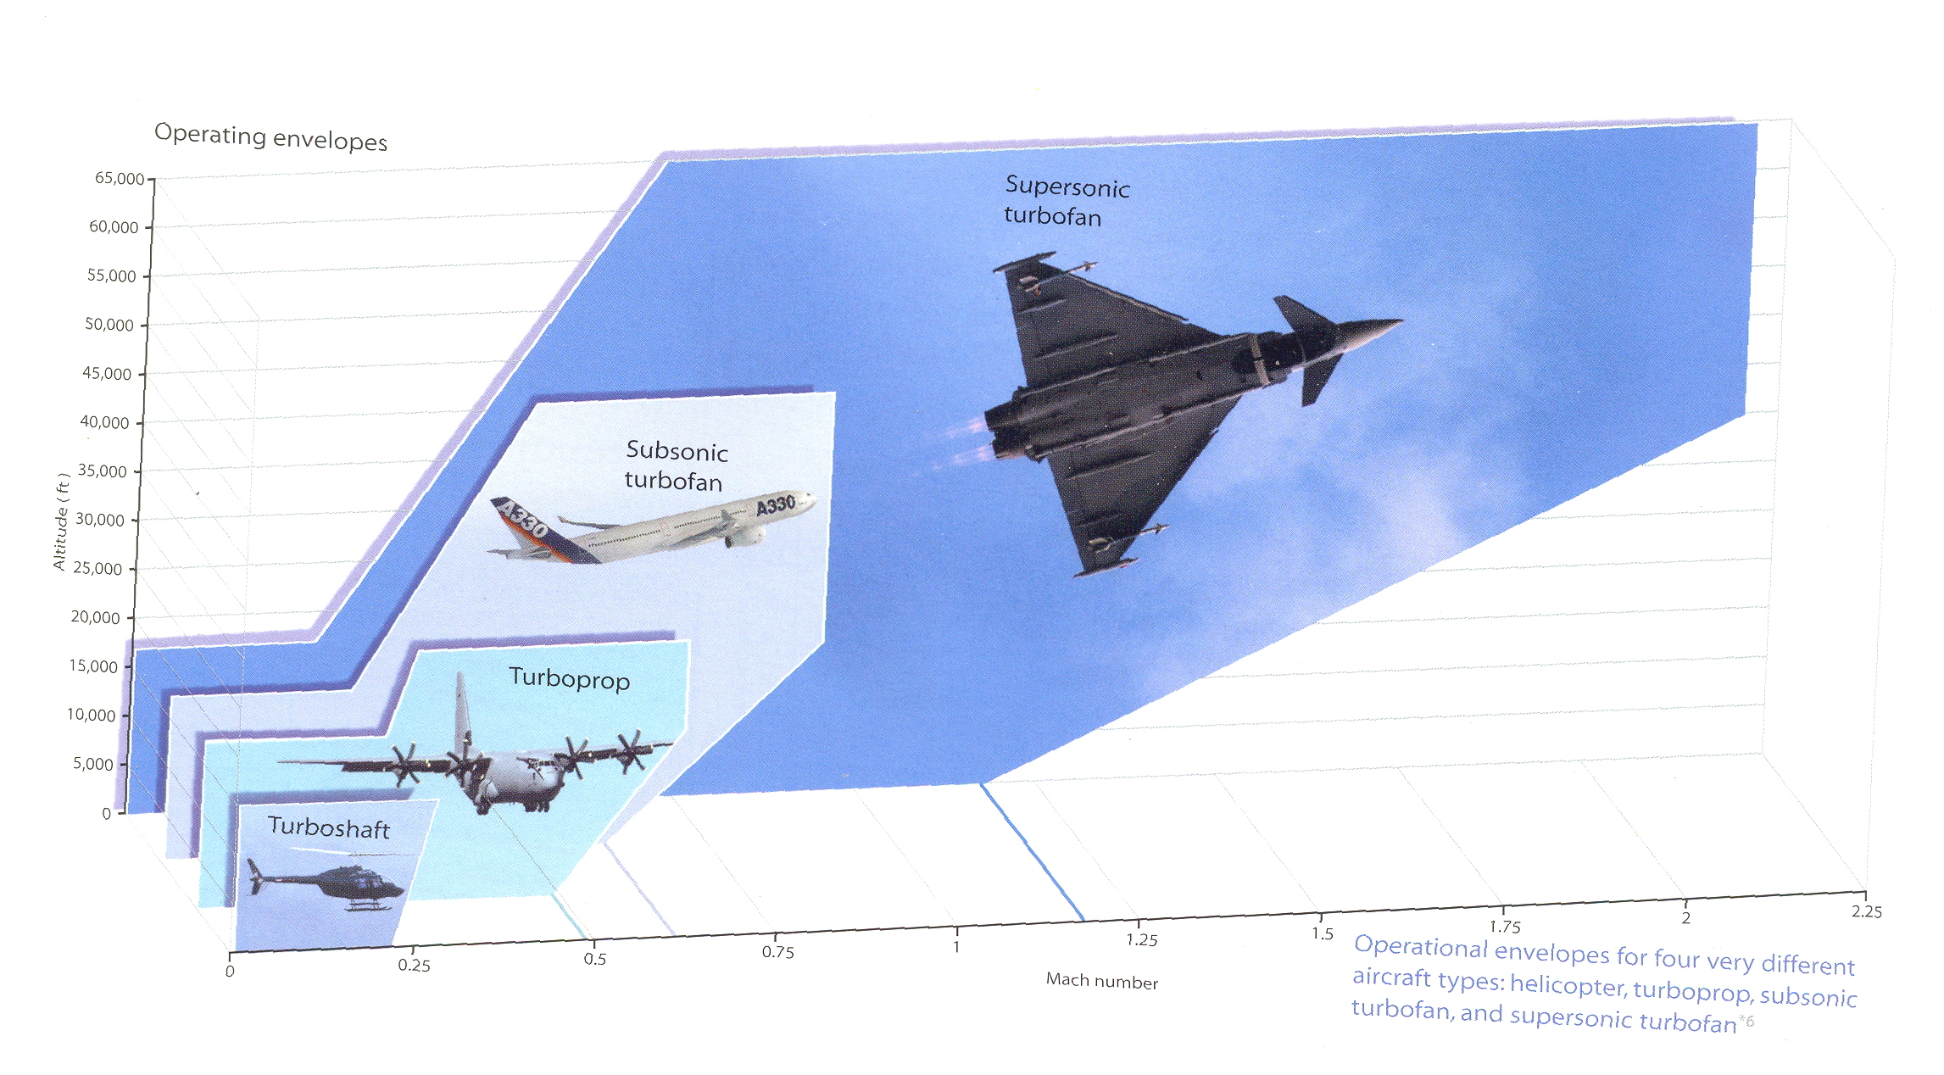
OPERATING RANGE OF DIFFERENT GAS TURBINE ENGINES

Slide 22
TURBOJET ENGINE
IT DERIVES ITS THRUST BY HIGHLY ACCELERATING A SMALL MASS OF AIR BY EXPANDING THE GASES THROUGH THE NOZZLE
TO OBTAIN HIGH VELOCITY THE TURBINE IS DESIGNED TO EXTRACT ONLY ENOUGH POWER FROM THE HOT GASES TO DRIVE THE COMPRESSOR AND THE ENGINE ACCESSORIES
REST IS CONVERTED INTO KINETIC ENERGY OF THE EXHAUST.

Slide 23
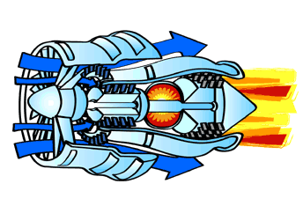
TURBOJET

Slide 24
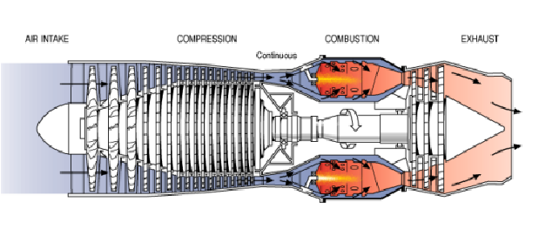
TURBOJET ENGINES

Slide 25
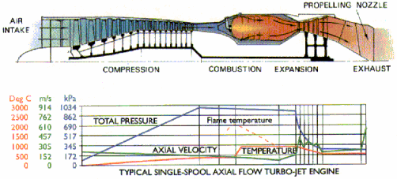

Slide 26
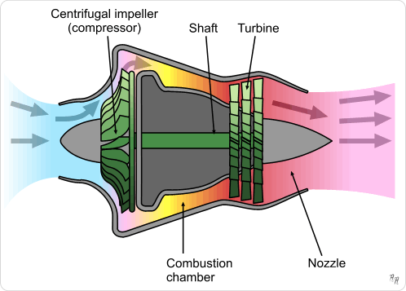
TURBOJET ENGINE (centrifugal compressor)

Slide 27
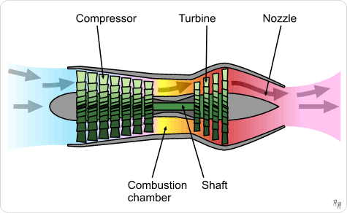
TURBOJET ENGINE (Axial compressor)

Slide 28
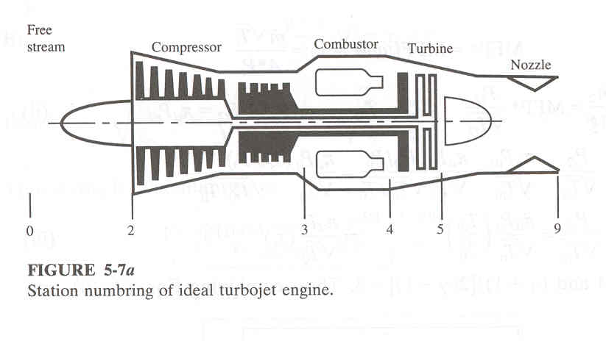
TURBOJET ENGINE

Slide 29
BRAYTON CYCLE
comb
P
exp
comp
T
suction
exhaust
V
S

Slide 30
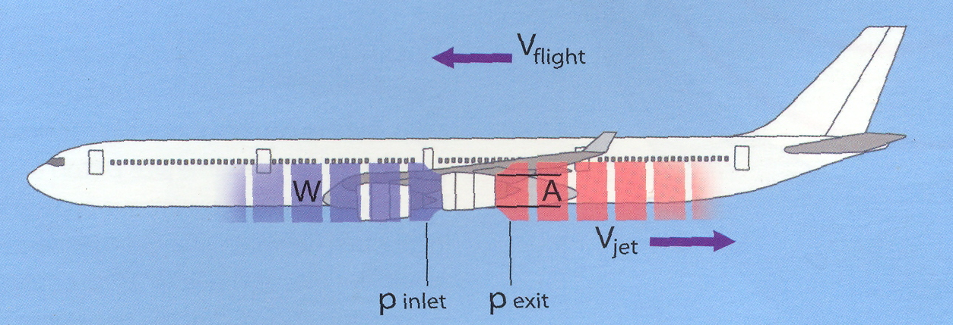
THRUST EQUATION

Slide 31
THRUST EQUATION
Fuel
Thrust
Va
Power unit
Vj
Pa
Pj
Thrust

Slide 32
ENGINE PERFORMANCE PARAMETERS
Thrust/ Wt ratio
It is the ratio of sp thrust to engine wt per unit mass flow
Engine wt/ unit mass flow is related to the efficiency of engine structure and the sp. Thrust is related to the engine thermodynamics

Slide 33
TEMPERATURE EFFECTS
GAS TURBINE ENGINES ARE VERY SENSITIVE TO VARIATION IN TEMPERATURE.
GENERALLY, THE GAS TURBINE ENGINES ARE RATED AT A STANDARD TEMP OF 15 DEG.
AS AMBIENT TEMPERATURE INCREASES, THRUST REDUCES AND THRUST INCREASES WITH DROP IN TEMPERATURE.

Slide 34
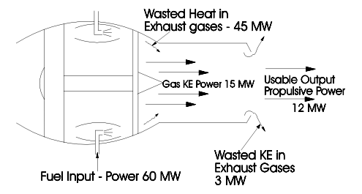

Slide 35
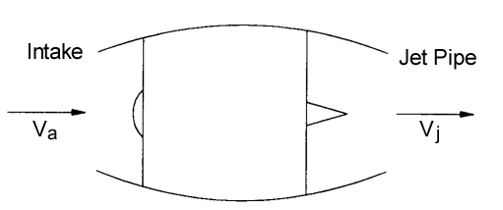
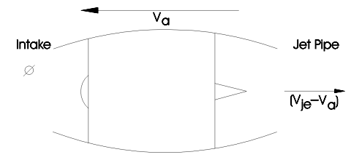

Slide 36
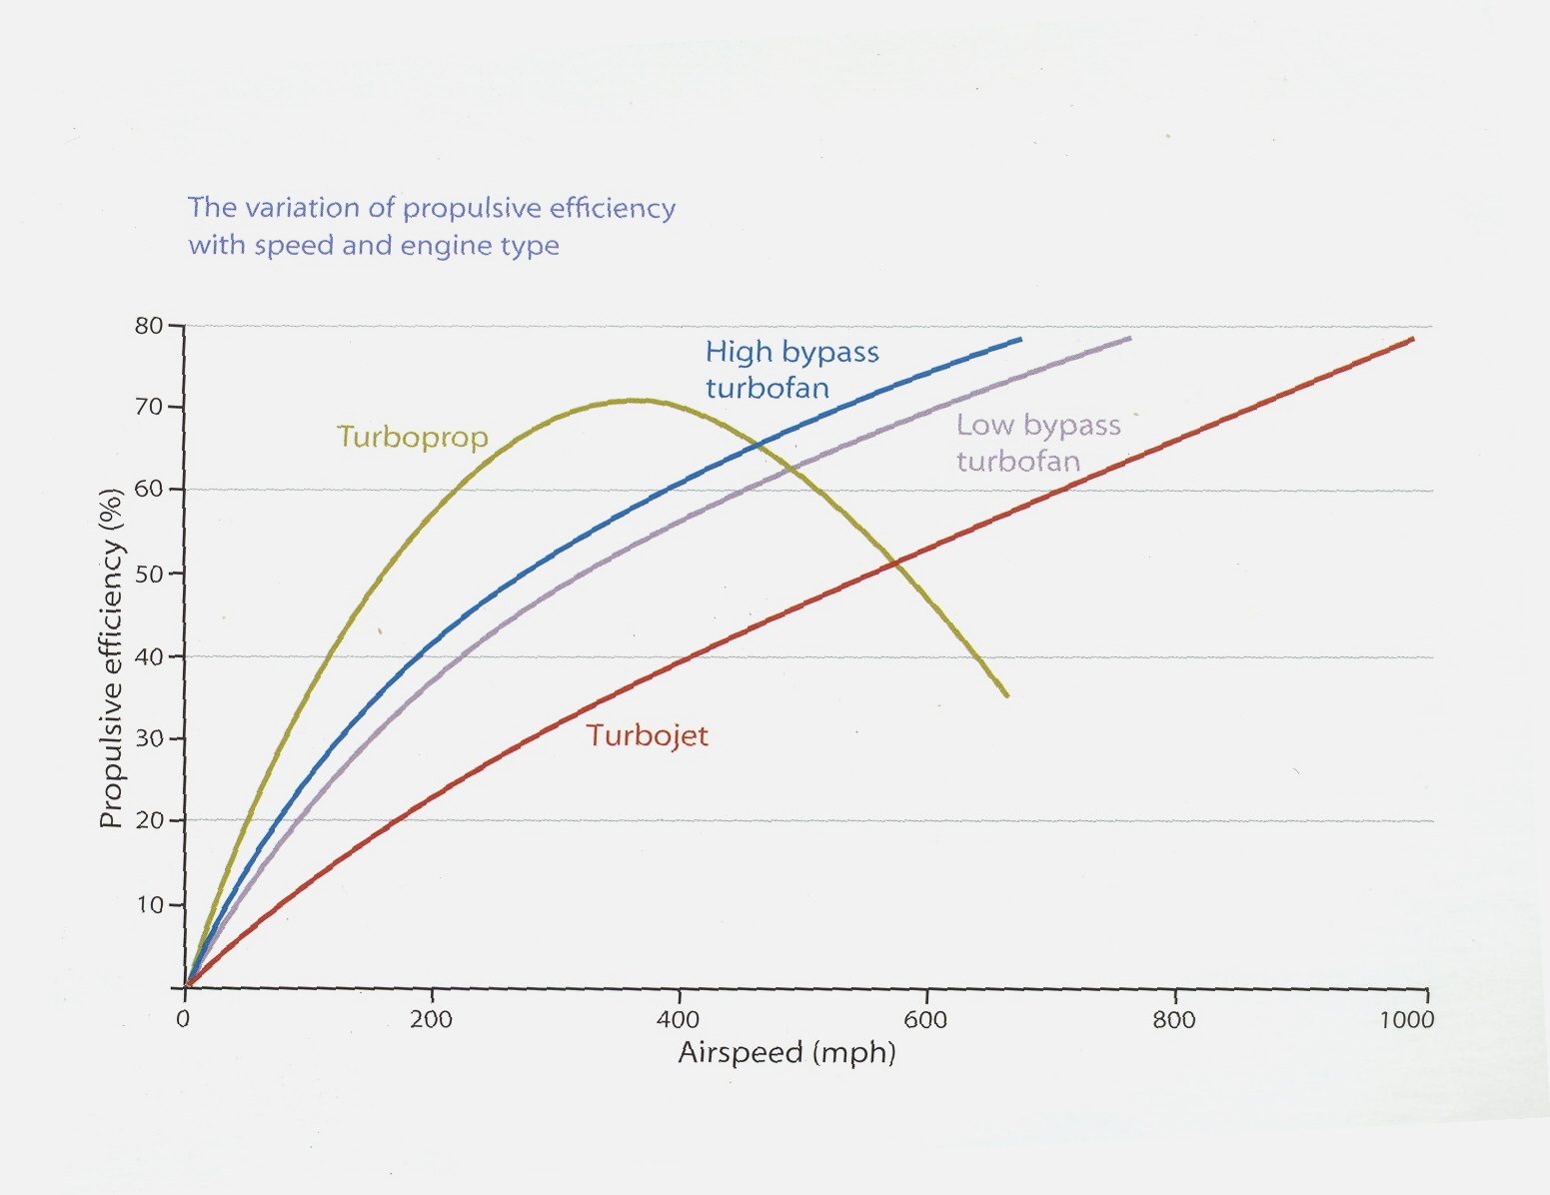
PROP. EFFICIENCY OF DIFFERENT GAS TURBINE ENGINES

Slide 37
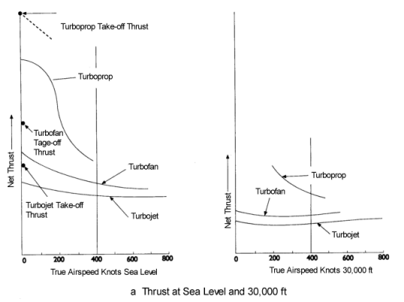

Slide 38
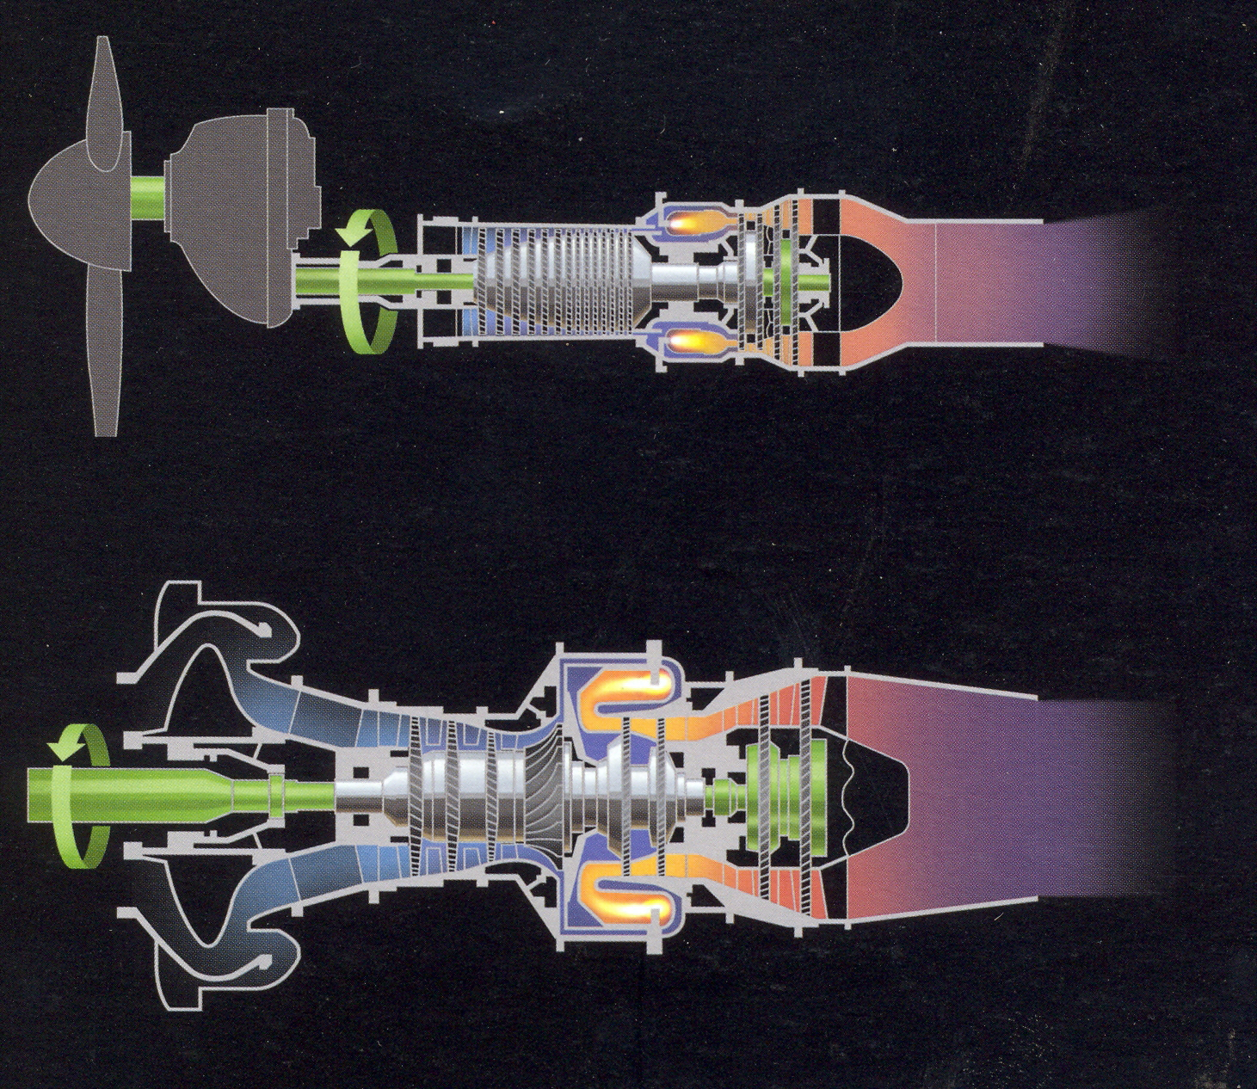
TURBO PROP ENGINE

Slide 39
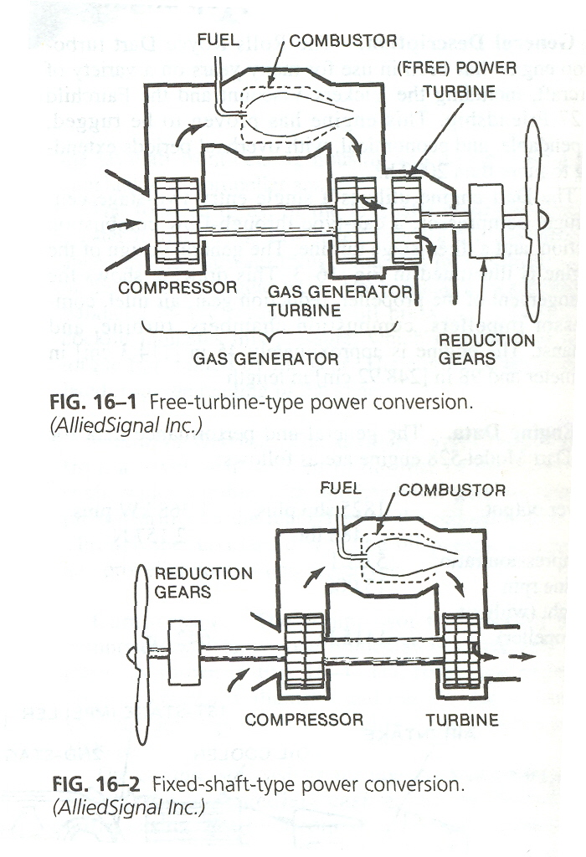
FIXED SHAFT TYPE POWER CONVERSION

Slide 40
TURBOPROP ENGINES
THIS IS BASICALLY A TURBOJET ENGINE WITH AN ADDITIONAL COMPONENT CALLED PROPELLER.
THESE PROPELLERS FORCE A LARGE MASS OF AIR (MORE THAN TURBOJET) TO ACCELARATE THUS PRODUCING THRUST( VELOCITY CHANGE IS LESSER THAN TURBOJET)
CONCENTRATION IS TO ACHIEVE HIGHER MASS FLOW THAN THE HIGHER VELOCITY CHANGES. GASES ARE NOT EXPANDED IN THE NOZZLE BUT EXPANDED IN THE TURBINE.
A MAJORITY OF GAS STREAM ENERGY IS CONVERTED INTO MECHANICAL ENERGY BY THE TURBINE
ENERGY IS UTILISED FOR DRIVING THE PROPELLERS IN FRONT OF THE ENGINE IN ADDITION TO COMPRESSOR AND ACCESSORIES

Slide 41
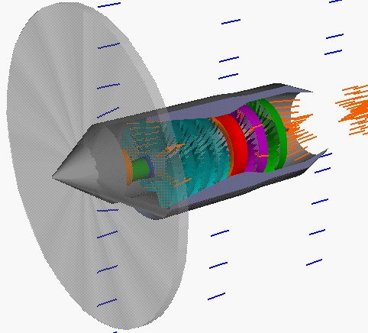
TURBOPROP ENGINES

Slide 42
CHARACTERSTICS
HIGH PROPELLER EFFICIENCY AT LOW AIR SPEEDS.
REDUCES TAKE OFF ROLL
EFFICIENCY DROPS WITH INCREASING AIR SPEED
MORE COMPLICATED IN DESIGN AND HEAVIER THAN TURBOJET
LARGE FRONTAL AREA, HENCE LONGER LANDING GEARS FOR LOW WING AIRCRAFT
EFFICIENT REVERSE THRUST POSSIBLE
SUPERIOR FOR LIFTING HEAVY LOADS AT SHORT TAKE OFF WHERE HIGH SPEEDS ARE NOT REQUIRED.

Slide 43
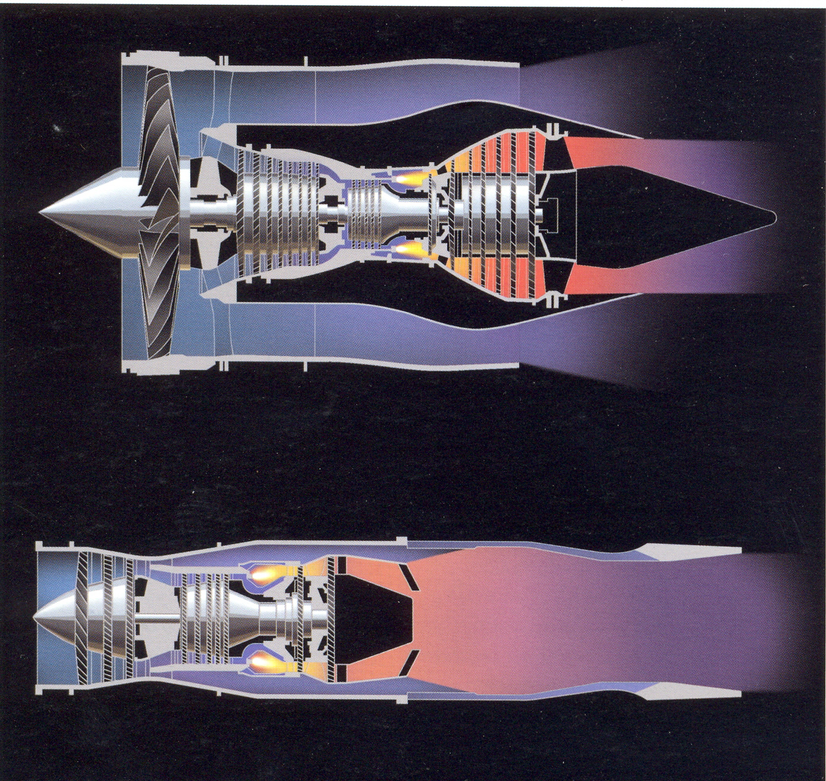
TURBOFAN ENGINE

Slide 44
TURBOFAN ENGINES
Has a duct enclosed fan mounted on the front or rear. Basically thrust augmented turbojet by dividing or increasing airflow.
Driven mechanically - geared down or at same speed as that of compressor by independent turbine located at rear of compressor-drive turbine.
Based on jet principle
Fans help increase mass flow
The fan air can exit engine separately or can be ducted back to mix with primary air at the rear, or the primary and secondary air flow can be mixed internally and then exit through a common nozzle

Slide 45
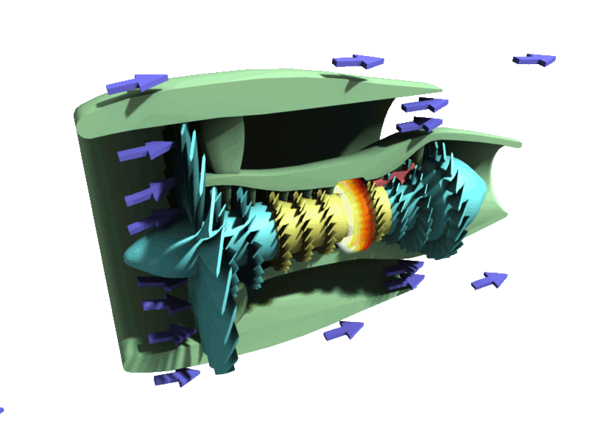
TURBOFAN

Slide 46
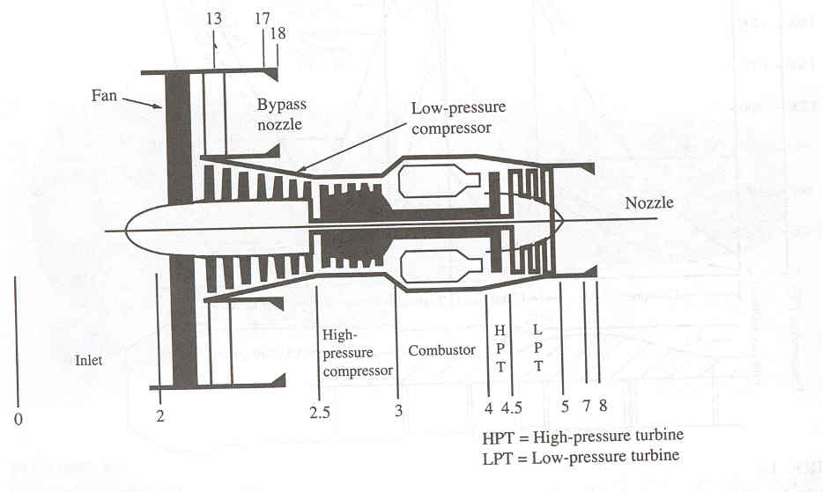
TURBOFAN ENGINE

Slide 47
CHARACTERSTICS
Increase in FPR(Fan Pressure Ratio) results in increase in fan thrust.
For any value of TIT, there is an optimum value of FPR
Optimum value of FPR for minimum SFC & max. Sp. Thrust coincide because of fixed energy input

Slide 48
CHARACTERSTICS
Increasing BPR(By Pass ratio) improves SFC at the expense of a significant reduction in Sp. thrust
Optimum FPR increases with TIT
Optimum SFC requires low Sp thrust, this being particularly important for high bypass turbofans.

Slide 49
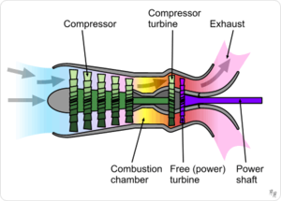
Turboshaft Engine

Slide 50
TURBOSHAFT ENGINES
Low weight, small size and large power output
Ideally suited for helicopter use
Main Parts of a Turboshaft engine
Air inlet or Diffuser
Gas generator compressor
Combustion chamber
Gas generator turbine
Power turbine
Exhaust nozzle

Slide 51
CHARACTERSTICS
Turboshaft engine must produce shaft power to drive the rotor. Hence another turbine section, the power turbine is placed in engine
Power turbine is commonly provided separately. It can be additional turbine on the gas generator turbine as in case of some turboprop engines

Slide 52
CHARACTERSTICS
More commonly there are two separate components
The gas generator compressor and turbine on one shaft and the power turbine on a second shaft
Both turbines are linked aerodynamically
Power turbine speed of 20,000 to 40,000 rpm is reduced to rotor speeds of 200 to 400 rpm through reduction gear box

Slide 53
CHARACTERSTICS
Shaft horse power (SHP) is the output measured at the engine output shaft which is driven by the power turbine.
Output shaft rpm is reduced from free turbine rpm in the order of 2 to 4. (from 24000 to 6000). This speed is further reduced to the helicopter speed through transmission reduction gearing

Slide 54
PROPFAN ENGINES
HAS A DUCT ENCLOSED FAN MOUNTED ON THE FRONT OR REAR
DRIVEN MECHANICALLY - GEARED DOWN OR AT SAME SPEED AS THAT OF COMPRESSOR BY INDEPENDENT TURBINE LOCATED AT REAR OF COMPRESSOR-DRIVE TURBINE.
BASED ON JET PRINCIPLE
FANS HELP INCREASE MASS FLOW
THE FAN AIR CAN EXIT ENGINE SEPARATELY OR CAN BE DUCTED BACK TO MIX WITH PRIMARY AIR AT THE REAR, OR THE PRIMARY AND SECONDARY AIR FLOW CAN BE MIXED INTERNALLY AND THEN EXIT THROUGH A COMMON NOZZLE

Slide 55
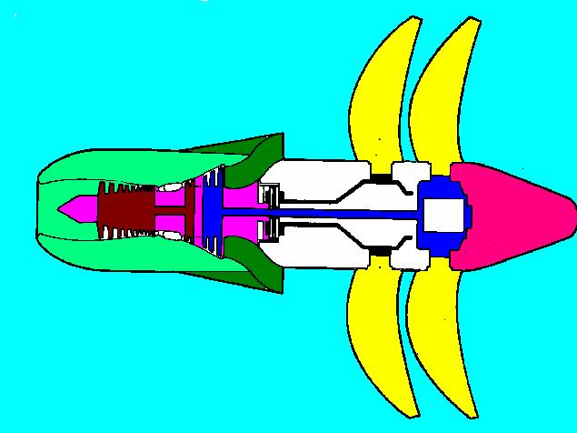
PROPFAN ENGINE

Slide 56
RAM JET ENGINES
It is a continuous flow jet engine with no major rotating parts
These make use of the ram effect of air at high velocities(near to sonic velocities for ramjet and supersonic velocities for scramjet)
Because of special countours of intake area, kinetic energy of high velocity air stream is conveted into static pressure energy thus increasing the pressure of the air

Slide 57
RAMJET ENGINE
Temp is raised by adding heat in the combustion chamber and then hot high pressure mass of air is expanded in the exhaust nozzle generating the thrust.
Require high initial velocity to obtain ram effect & are unsuitable for aircraft applications
Used in missiles and target vehicles

Slide 58
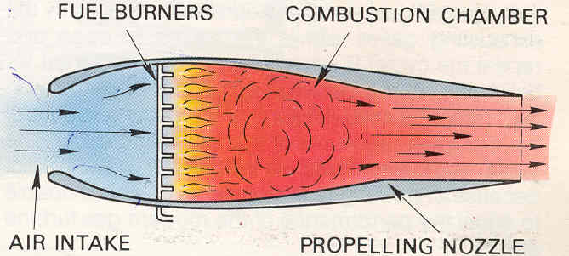
RAM JET ENGINE

Slide 59
PULSE JET ENGINE
These engines use the principle of intermittent(pulses) combustion.
Air enters through open valves at inlet in the combustion chamber where heat is added
Heat addition , increases pressure thus closing inlet valves

Slide 60
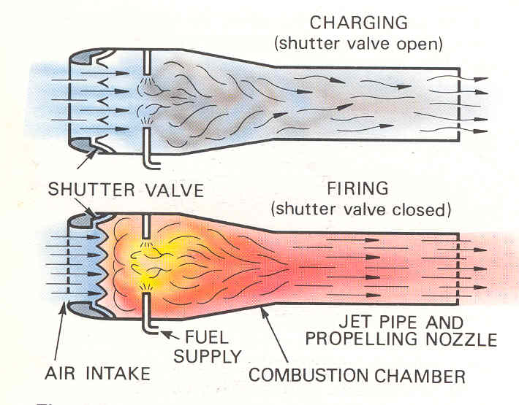
PULSE JET ENGINE

Slide 61
PULSE JET ENGINE
High pressure energy is expanded in exhaust nozzle, thus producing thrust
Depression created by the exausting gases allows the valve to open and the cycle is repeated
Pulse jet engines have been designed for helicopter rotor propulsion
Not suitable as an aircraft powerplant due to high fuel consumption and unable to match performance of modern gas turbine engine

Slide 62
ROCKET ENGINES
These engines do not use surrounding medium for propulsion
The working medium which generates the propulsive force or thrust is wholly carried within the propelled body.

Slide 63
TYPES OF CHEMICAL ROCKET ENGINES
LIQUID PROPELLANT
SOLID PROPELLANT
GASEOUS
HYBRID

Slide 64
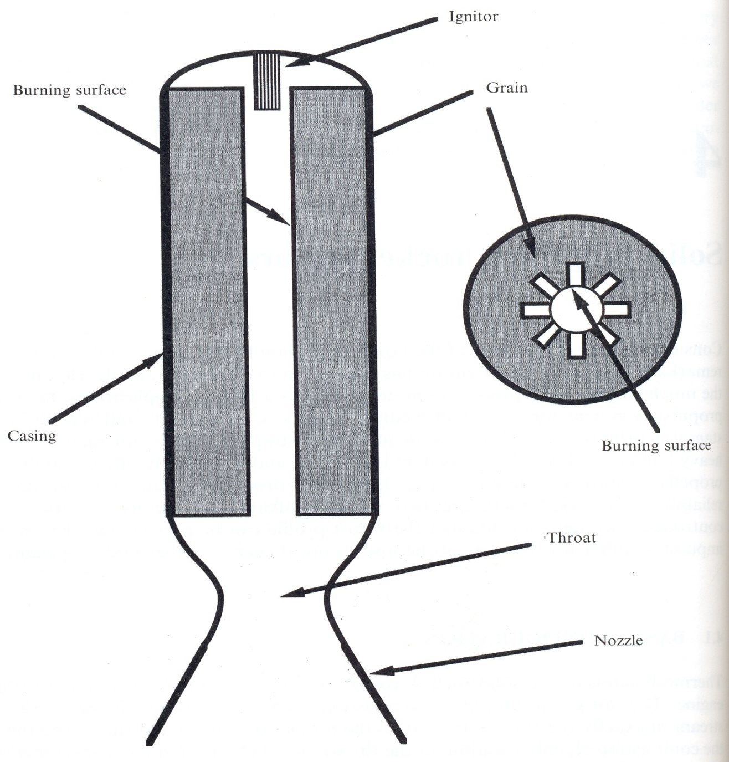
SOLID PROPELLLANT ENGINES

Slide 65
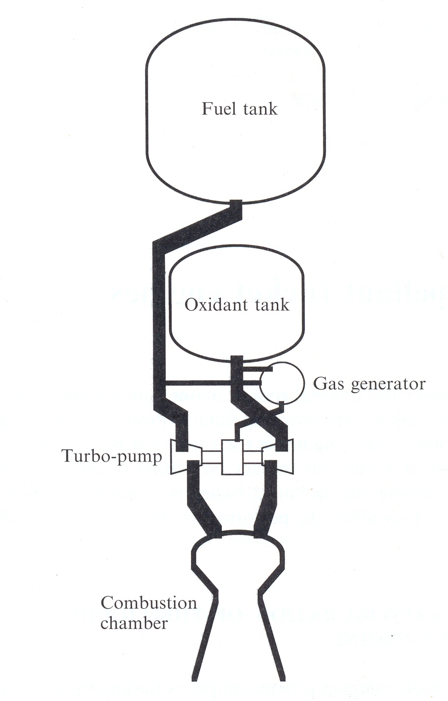
LIQUID PROPELLANT ENGINES

Slide 66
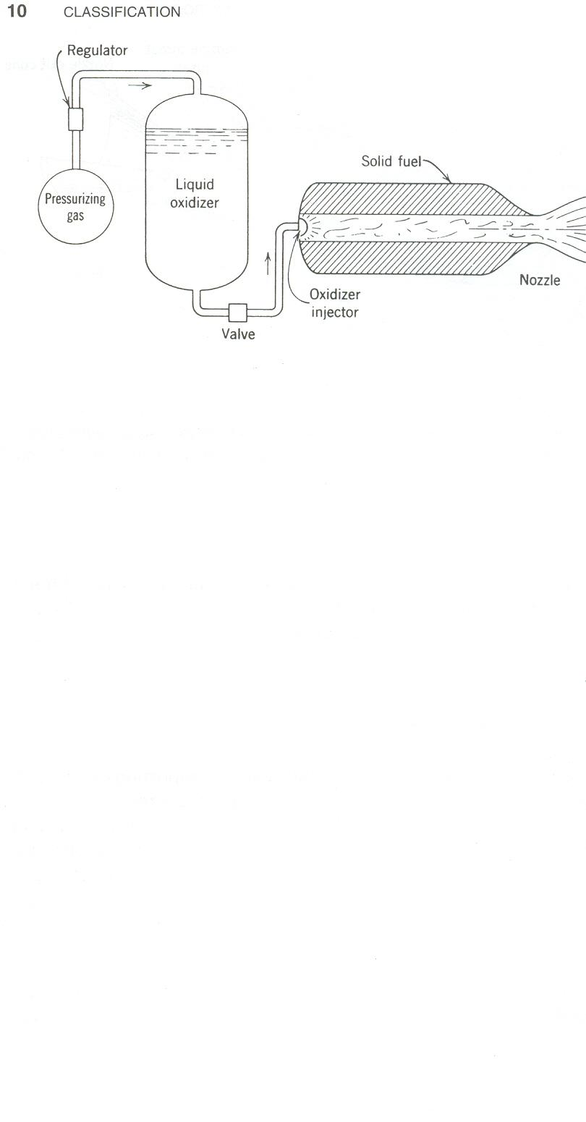
HYBRID PROPELLANT ENGINES

Slide 67
PERFORMANCE PARAMETERS OF ROCKET ENGINES
COMBUSTION TEMP. (T₀) IS PRIMARILY DICTATED BY CHEMISTRY OF FUEL & OXIDIZER. THE MORE REACTIVE THE PROPELLANTS ARE, THE HIGHER IS T₀
SIMILARLY THE LIGHTER THE PROPELLANT, HIGHER IS SP. IMPULSE
FOR A GIVEN FUEL/OXIDIZER COMBINATION, WE CANNOT DO MUCH OTHER THAN CHANGE THE FUEL/OXIDIZER RATIO.

Slide 68
SOLID PROPELLLANT ENGINES
It consists of a casing for the propellant which joins to a nozzle of identical geometry.
The charge of propellant in a solid rocket motor is often called the grain.
The basic components of the grain are fuel, oxidant, binder & additives to achieve burning stability & stability in storage.

Slide 69
SOLID PROPELLLANT ENGINES
In most cases the grain is bonded to the wall of the combustion chamber
Thrust depends on the rate at which grain is consumed.

Slide 70
SOLID PROPELLLANT ENGINES
Advantages
Simplicity i.e absence of turbo pumps, separate propellant tanks, complicated valves & pipelines produces a high mass ratio, low cost or both
Reliability is very high due to small no. Of individual components

Slide 71
SOLID PROPELLLANT ENGINES
Disadvantages
Low exhaust velocity (2700m/s)
Device cannot be test fired and so reliability has to be established by analogy and by quality control
Uses
Excel as strap on boosters and as upper stages particularly for orbital insertion

Slide 72
SOLID PROPELLLANT ENGINES
 | Space shuttle(srb) | Mps(ariane 5)
Propellant used | Ammonium perchlorate- 68 % Al powder- 16 to 18 % Polymeric binder- 14 % Additive iron oxide – 0.4 %

Slide 73
LIQUID PROPELLANT ENGINES
It comprises of the combustion chamber, nozzle & propellant tanks together with the means to deliver the propellants to the combustion chamber. Use liquid fuel and oxidiser
Liquid is pressure fed or pump fed
Design is complex as it houses liquid tanks, pumps , precision valves, pipelines etc
Combustion process is controlled

Slide 74
LIQUID PROPELLANT ENGINES
Cooling of combustion chamber and nozzle is a must due to high temp( 3000 k)
Combustion chamber comprises injectors through which propellant enter, the vaporisation , mixing and combustion zones & restriction leading to the nozzle.
Specific injector has to take into account the nature of propellants.

Slide 75
HYBRID PROPELLANT ENGINES
Combination of solid and liquid propellants
Has advantages of both the types and used in space launch vehicles
Gaseous propellant engine
Use high pressure stored gas as their working fluid
It requires heavy tanks and complicated systems

Slide 76
THERMAL EFFICIENCY
PROPULSIVE EFFICIENCY
ENGINE EFFICIENCY
OVERALL CYCLE EFFICIENCY
SPECIFIC FUEL CONSUMPTION
SPECIFIC THRUST

Slide 77
Thermal efficiency indicates the thermodynamic capacity of the cycle to convert heat into work.
Propulsive efficiency is a measure of the effectiveness of the engine in propelling the aircraft or conversion capability of KE into thrust. Ratio of useful work output to energy input.
Engine efficiency is the energy conversion capacity of the powerplant i.e. conversion rate of energy supplied by fuel to KE.

Slide 78
Overall efficiency is a product of propulsive and engine efficiency
SFC is fuel consumption per unit thrust and helps in discarding efficiency. This helps in deciding economic feasibility.
Specific Thrust is the thrust per unit mass flow of air. This helps in deciding the size, frontal area, drag, relative size of engines for same thrust etc.

